Slide 1


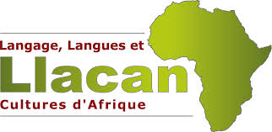
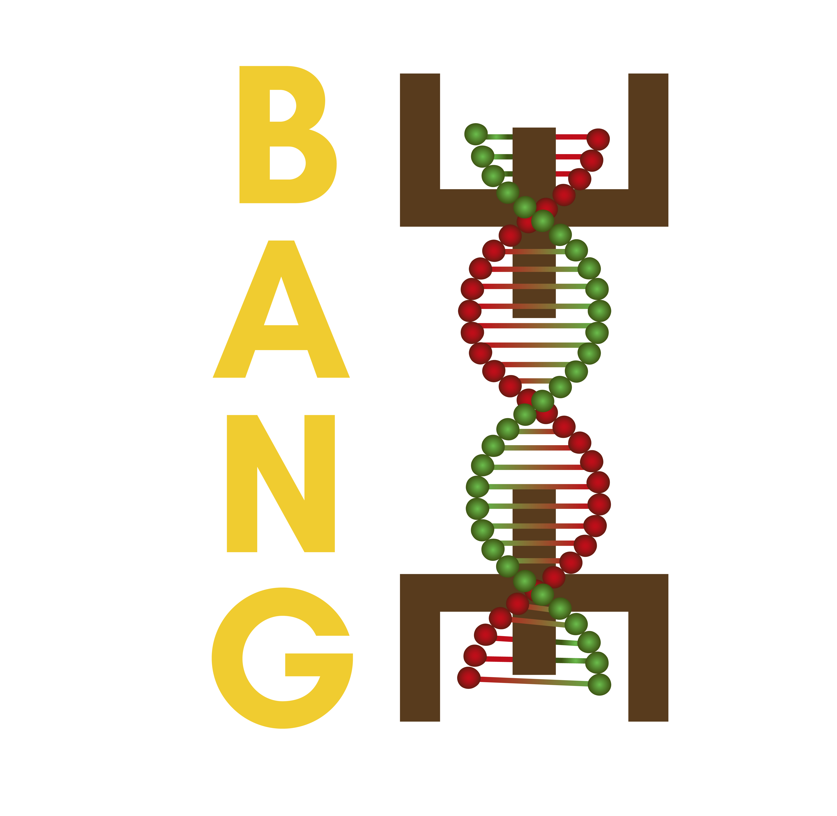
computer-assisted historical language comparison: an African linguistics perspective
Promise Dodzi Kpoglu
7th June 2024, UCAD, Dakar
promise-dodzi.kpoglu@cnrs.fr/promisedodzi@gmail.com
The research is being funded by a grant from the European Research Council (ERC) under the European Union’s Horizon Europe Framework Programme (HORIZON) grant number 101045195.

Slide 2
Outline
Introduction
General introduction
Objectives
Significance
From data to cognate sets in automatic approaches
Data in this study:
The raw data
Data cleaning steps
Cognate detection
The input
The cognate set
Conclusion

Slide 3
Introduction
Confronted with a number of languages that show variant degrees of similarity and differences, one of the first tasks of the linguist/anthropologist is to understand the relationships between these languages.
Historically, two main approaches have been employed:
Swadesh-like approaches (Lexicostatistics)
Greenberg-like approaches(Mass comparison)
Whatever the approach, some discrete (non mutually exclusive) steps are often involved in such historical linguistics work.

Slide 4
Introduction
Discrete (mutually non-exclusive) steps can involve:
Cognate identification: words that are related, especially in form – see Jäger 2019.
Establishment of sound correspondences –see List et al 2022, Kim et al 2023.
Proto-form reconstruction- See Meloni et al 2021 for instance.
Time-depth estimation – See Gray & Atkinson 2003, 2006.
Phylogenetic relationships – See Rama et al 2018.
[ wordlist ]
Language | Family | Time-depth | Proto-form | Cognates
French | Romance | ~1000 | cane [ kane ] | chien [ ʃiɛ̃ ]
Italian | Romance | ~1000 | cane [ kane ] | cane [ kane ]
Spanish | Romance | ~1000 | cane [ kane ] | can [ kan ]

Slide 5
Objectives
I concentrate on cognate-detection and show how automated methods can be employed in this task.
The objectives of this presentation are thus two-fold:
Show how raw data is processed for automated approaches to comparative historical linguistics work.
Demonstrate the methods involved in cognate detection.
Present preliminary results from these methods used on data available within the BANG project.

Slide 6
Significance
The results in this presentation are pertinent for two reasons:
Data processing techniques presented here can be relevant for other African languages.
Methods used in this study are transferable to workflows defined for different projects that involve linguistic data.
Perfected methods are going to be used with data in which Bangime, the object of study of the current project, will be integrated.

Slide 7
Computational methods in cognate detection
Computationally, it is generally understood that cognate detection involves two major steps (Rama et al 2018: 4):
Word similarity calculation: how close, often phonetically, are groups of words?
Cognate set partitioning : proposing sets and putting proposed cognates in these sets.
A third stage induced by this two-step approach is phonetic alignment - cognate sets are aligned (List et al 2022:90).
Align the proposed cognate sets for further analysis.

Slide 8
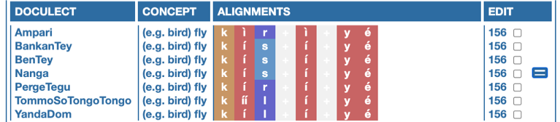
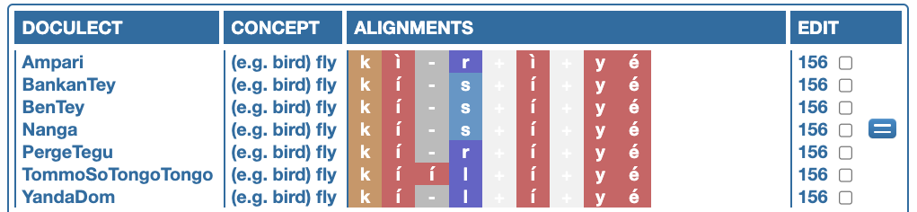
Computational methods in cognate detection
Alignment analyses have the advantage of :
helping to model differences between sequences.
allowing us to compare sequences i.e. cognates.

Slide 9
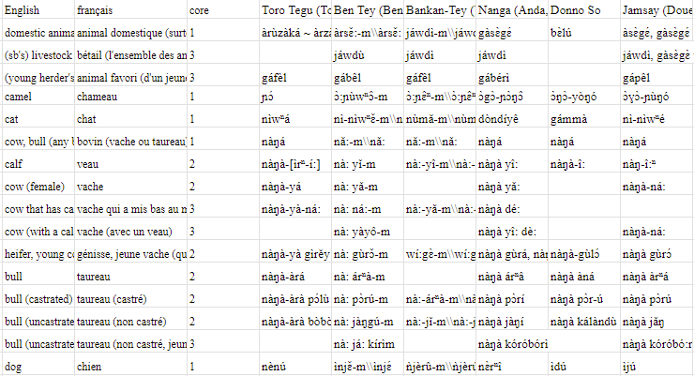
Data in this study: the raw data
Data is from the Dogon and Bangime Linguistics project.
Data similar to data curated by linguists working on the field.

Slide 10
Data in this study: data cleaning steps
The steps taken to get the data into computer digestable format are of three main types:
All manual process
Semi-manual process
Manual process involved:
Removal of non alpha-numeric symbols (‘,’, ‘)’, ‘/’)
‘Columnization’ and ‘Rowing’:
Columns: ID, language, concepts, singular, plural
Rows: 1 ID, 1 language, 1 concept, 1 singular form, 1 plural form
Consensus forms, for especially verbs

Slide 11
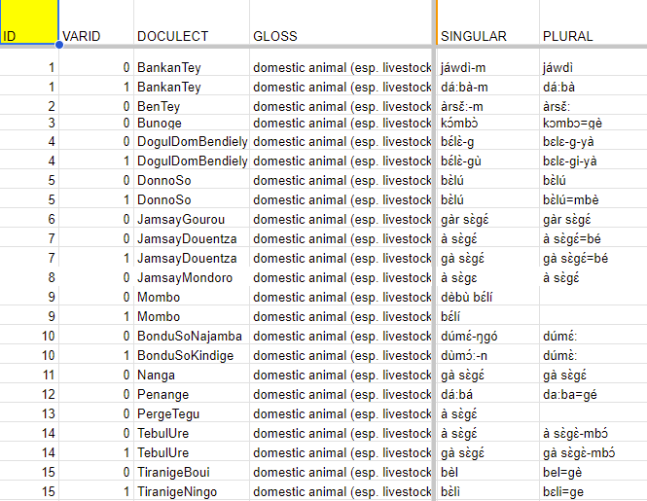
Data in this study:data cleaning steps
Data after manual process:

Slide 12
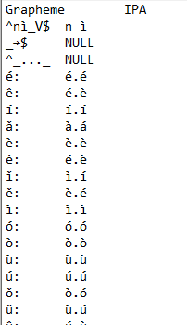
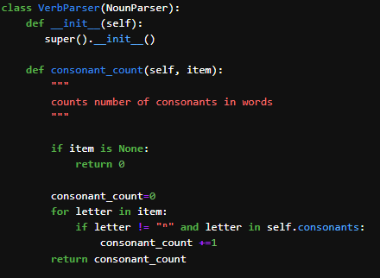
Data in this study: data cleaning steps
Semi-manual process involved:
Identifying morphotactic properties
Writing segmenting rules in the python programming language
Parsing the data based on these rules
Identifying morphotactic properties:
Reading grammars on the languages
Writing rules:
Using python to encode the rules
Parsing data:
Running python script on data
Stabilizing graphemes using an orthography profile

Slide 13
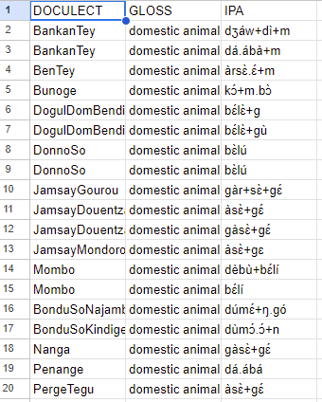
Data in this study: data cleaning steps
Data after semi-manual process:

Slide 14
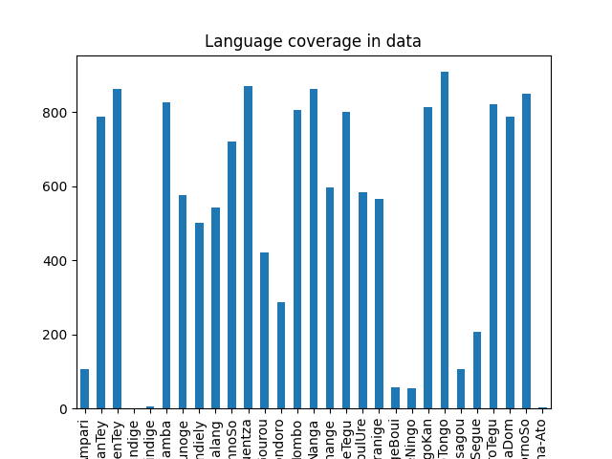
Cognate detection: the input
For cognate detection to be efficient, data must have not just enough words, but also enough comparable word pairs; the higher the better.
List(2017) suggests a minimum of 100 comparable words i.e. 100 concept pairs.
288 concept pairs

Slide 15
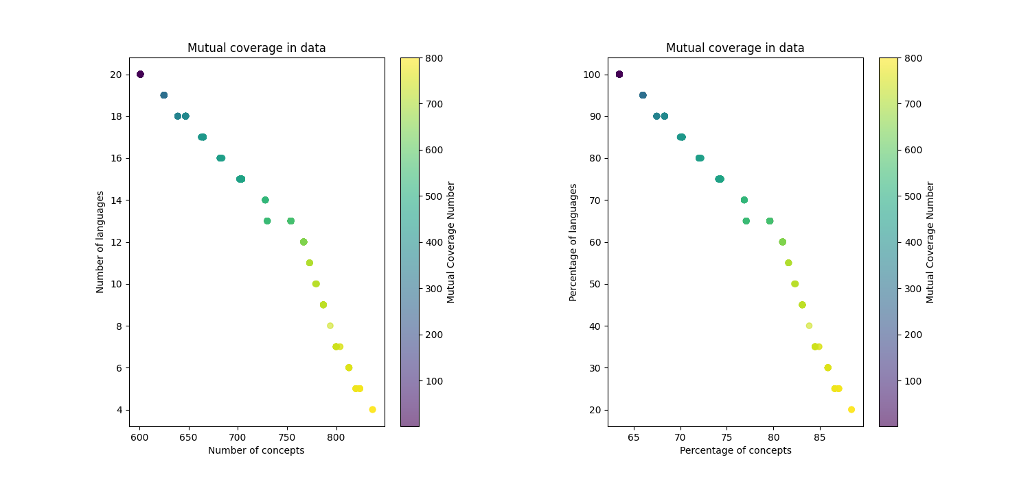
Cognate detection: the input
Cleaned data had 20 languages with a minimum of 53% concept coverage i.e. 288 concepts.

Slide 16
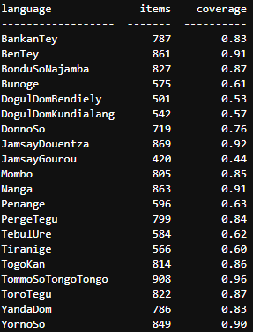
Cognate detection: the input
The languages that the cleaned dataset contains are shown below.

Slide 17
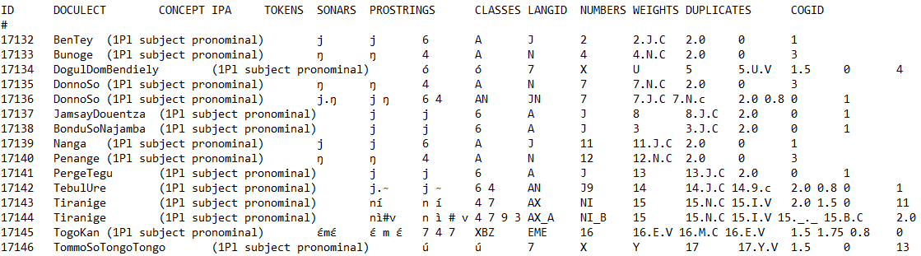
Cognate detection: the cognate set
The new data are then fed into the Lexstat model of Lingpy - a model that has been shown to be impressively effective for automated comparative historical linguistics (List et al 2023).
The Lingpy model outputs a .tsv file that contains the determined cognate sets.
COGID in the .tsv file is indicative of cognacy.

Slide 18
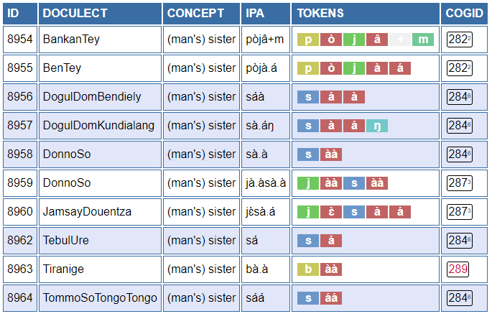
Cognate detection: the cognate set
Alignments can be obtained using the Alignment class in Lingpy:
Alignments can then be visualized using Edictor (List et al 2017).

Slide 19
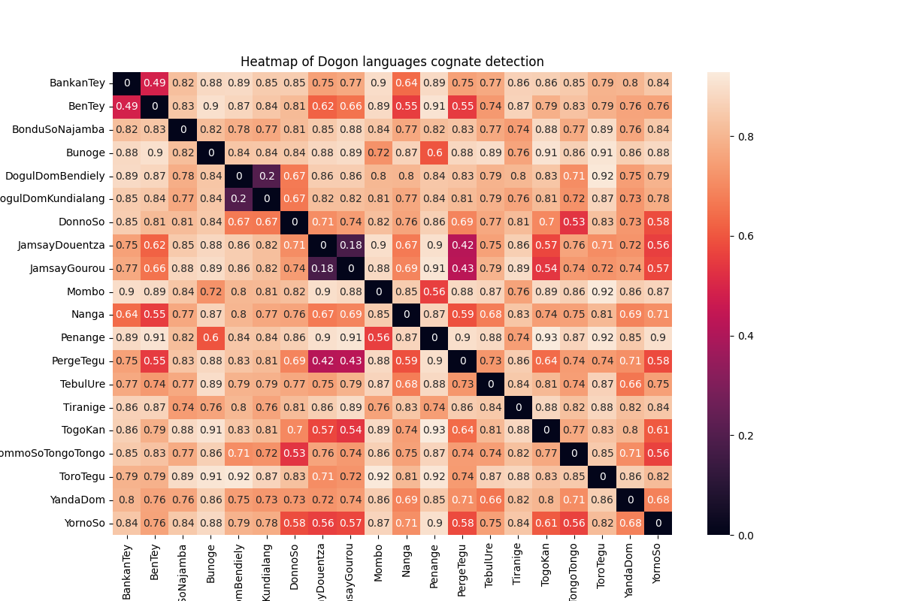
Cognate detection: the cognate set
Another option is to obtain the distance matrix calculated from the cognate detection algorithm – the lower, the closer.

Slide 20
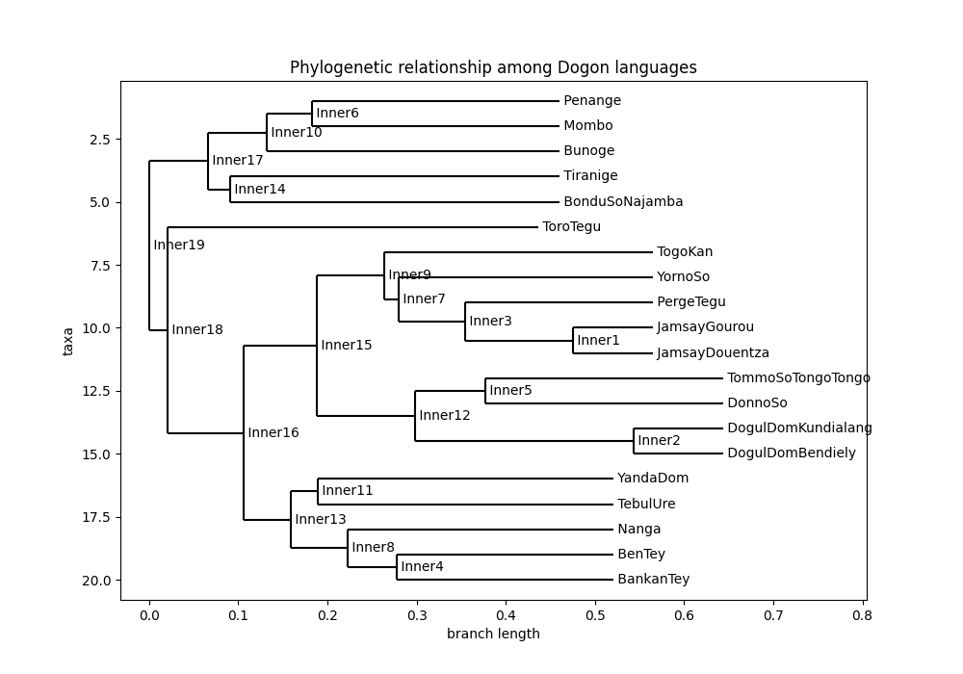
Cognate detection: the cognate set
An even more exciting option is to use the distance matrix to obtain a phylogenetic tree (either via clustering algorithms, or the more specialized methods like UPGMA)

Slide 21
Conclusion
This study has sought to show how raw data, from an African linguistics fieldwork, can be processed for automated computation in historical linguistics.
An even more exciting approach involves going through a CLDF workflow
Three process have been noted as critical:
Data formatting: ‘columnization’ and ‘rowing’
Data cleaning: deletions and concatenations
Data preparation: segmentation and stabilization
Once data is processed, various algorithms exist to conduct highly specialized modeling that can give critical insights.
More importantly is the fact that, these methods are applicable to various linguistic landscapes, and is especially useful for the African case, where debates still rage on about some proposed phylogenetic relationships.
They thus can be used to either confirm these relationships, or call them into question.

Slide 22
Data in this study: the raw data
Data is from the Dogon and Bangime Linguistics project.
Data similar to data curated by linguists working on the field.

Slide 23
Thank you
All code used for this presentation is publicly available on Github at:
https://github.com/PromiseDodzi/UCAD-presentation

Slide 24
Bibliography
Atkinson, Q. D., & Gray, R. D. (2006). How old is the Indo-European language family? Illumination or more moths to the flame. In Phylogenetic methods and the prehistory of languages (pp. 91-109).
Blum, F., & List, J.-M. (2023). Trimming phonetic alignments improves the inference of sound correspondence patterns from multilingual wordlists. In Proceedings of the 5th Workshop on Computational Typology and Multilingual NLP (pp. 52-64). Association for Computational Linguistics.
Creissels, D. (2019). Morphology in Niger-Congo languages. In Oxford Research Encyclopedia of Linguistics.
Dimmendaal, G. J. (2008). Language ecology and linguistic diversity on the African continent. Language and Linguistics Compass, 2(5), 840-858.
Forkel, R., Moran, S., List, J. M., Greenhill, S. J., Ashby, L. C., Gorman, K., & Kaiping, G. (2019). Segments: Unicode standard tokenization routines and orthography profile segmentation [Software Library, Version 2.1.3].
Forkel, R., List, J. M., Greenhill, S. J., Rzymski, C., Bank, S., Cysouw, M., ... & Gray, R. D. (2018). Cross-Linguistic Data Formats, advancing data sharing and re-use in comparative linguistics. Scientific data, 5(1), 1-10.
Gray, R. D., & Atkinson, Q. D. (2003). Language-tree divergence times support the Anatolian theory of Indo-European origin. Nature, 426(6965), 435-439.
Hantgan-Sonko, A. (2019). Linguistic support for an early Dogon diffusion. Poster presented at the Peopling History of Africa conference, Geneva, Switzerland.
Hantgan-Sonko, A., & List, J. M. (2022). Bangime: Secret language, language isolate, or language island? A computer-assisted case study. Papers in Historical Phonology, 7, 1-43.
Heath, J. (2017). A grammar of Bunoge (Dogon, Mali).
Heath, J. (2017). A grammar of Tebul Ure (Dogon, Mali).
Heath, J. (2023). A grammar of Tebul Ure (Dogon, Mali).
Hochstetler, J. L., Durieux, J. A., & Durieux-Boon, E. I. (2004). Sociolinguistic survey of the Dogon language area. SIL International.
Kim, Y. M., Chang, K., Cui, C., & Mortensen, D. (2023). Transformed protoform reconstruction. arXiv preprint arXiv:2307.01896.
List, J. M. (2012). Multiple sequence alignment in historical linguistics. In Proceedings of ConSOLE (Vol. 19, pp. 241-260).
List, J. M. (2017). Historical language comparison with LingPy and EDICTOR. https://doi.org/10.5281/zenodo.1042205.
List, J. M., Forkel, R., & Hill, N. W. (2022). A new framework for fast automated phonological reconstruction using trimmed alignments and sound correspondence patterns. arXiv preprint arXiv:2204.04619.
List, J. M., Walworth, M., Greenhill, S. J., Tresoldi, T., & Forkel, R. (2018). Sequence comparison in computational historical linguistics. Journal of Language Evolution, 3(2), 130-144.
List, J.-M. (2012a). LexStat: Automatic detection of cognates in multilingual wordlists. In Proceedings of the EACL 2012 Joint Workshop of Visualization of Linguistic Patterns and Uncovering Language History from Multilingual Resources (pp. 117-125). Stroudsburg.
List, J.-M. (2012b). SCA: Phonetic alignment based on sound classes. In M. Slavkovik & D. Lassiter (Eds.), New directions in logic, language, and computation (pp. 32-51). Berlin and Heidelberg.
List, J.-M., Greenhill, S., & Forkel, R. (2023). LingPy Documentation Release 2.6.
List, J.-M., Walworth, M., Greenhill, S. J., & Tresoldi, T. (2017). The potential of automatic word comparison for historical linguistics. PLOS ONE, 12(1), 1-18.
Moran, S., & Prokić, J. (2013). Investigating the relatedness of the endangered Dogon languages. Literary and Linguistic Computing, 28(4), 676-691.
Moran, S., Forkel, R., & Heath, J. (2016). Dogon and Bangime linguistics. Jena: Max Planck Institute for the Science of Human History.
Rama, T., List, J. M., Wahle, J., & Jäger, G. (2018). Are automatic methods for cognate detection good enough for phylogenetic reconstruction in historical linguistics? arXiv preprint arXiv:1804.05416.

Slide 25
